Slide 1
Successful GAMEs during 2019 - 2024
BY ATHUL K M
MSC GT

Slide 2

Games during 2019 - 2024
From 2019 to 2024, the gaming industry flourished with innovative titles. In 2019, games like Sekiro: Shadows Die Twice pushed boundaries in gameplay and design. 2020 introduced The Last of Us Part II, noted for its emotional depth. 2021 featured Resident Evil Village, combining horror with action. 2022 was dominated by Elden Ring, which redefined open-world design. In 2023, Cyberpunk 2077: Phantom Liberty revitalized the franchise, while 2024 saw titles like Marvel's Spider-Man 2 and Final Fantasy VII Rebirth, showcasing the evolution of storytelling and mechanics.

Slide 3






2019
In 2019, the PC gaming world saw several major releases across genres, many of which became widely popular and influential. Some of the top PC games of 2019 were a mix of AAA titles and some remarkable indie games. Here’s a look at some of the most successful PC games of that year:
Sold over 10 Million Copies
Sold over 14.2 Million Copies
Sold over 4.5 Million Copies
Sold over 130 Million Copies
Sold over 3 Million Copies
Sold over 5 Million Copies

Slide 4






2019
Sold over 6 Million Copies
Sold over 200,000 Copies
Sold over 1.5 Million Copies
Sold over 10 Million Copies
Sold over 61 Million Copies
Sold over 10 Million Copies

Slide 5




2019
Sold over 20 Million Copies
Sold over 61 Million Copies
Sold over 26.35 Million Copies
Sold over 14.25 Million Copies

Slide 6






2020
2020 was a memorable year for PC gaming, with a diverse range of hit titles across genres. Here are some of the top-performing and most acclaimed PC games of 2020:
Sold over 25 Million Copies
Sold over 500 Million Copies
Sold over 2.7 Million Copies
Sold over 3 Million Copies
Sold over 150 Million Copies
Sold over 48.85 Million Copies

Slide 7


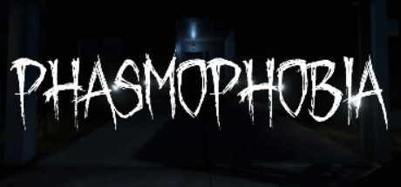



2020
Sold over 1 Million Copies
Sold over 15 Million Copies
Sold over 20 Million Copies
Sold over 3 Million Copies
Sold over 5 Billion Copies
Sold over 2.5 Million Copies

Slide 8






2020
Sold over 10 Million Copies
Sold over 13 Million Copies
Sold over 14.1 Million Copies
Sold over 6.5 Million Copies
Sold over 20 Million Copies
Sold over 1.4 Million Copies

Slide 9






2021
2021 brought an exciting variety of successful and critically acclaimed games to the PC, spanning genres from indie hits to AAA blockbusters. Here’s a look at some of the standout PC games of 2021:
Sold over 10 Million Copies
Sold over 12 Million Copies
Sold over 40 Million Copies
Sold over 20 Million Copies
Sold over 20 Million Copies
Sold over 6 Million Copies

Slide 10






2021
Sold over 5 Million Copies
Sold over 3 Million Copies
Sold over 4.23 Million Copies
Sold over 4.5 Million Copies
Sold over 10 Million Copies
Sold over 1.7 Million Copies

Slide 11






2021
Sold over 35 Million Copies
Sold over 1 Million Copies
Sold over 3 Million Copies
Sold over 33.7 Million Copies
Sold over 3 Million Copies
Sold over 1 Million Copies

Slide 12
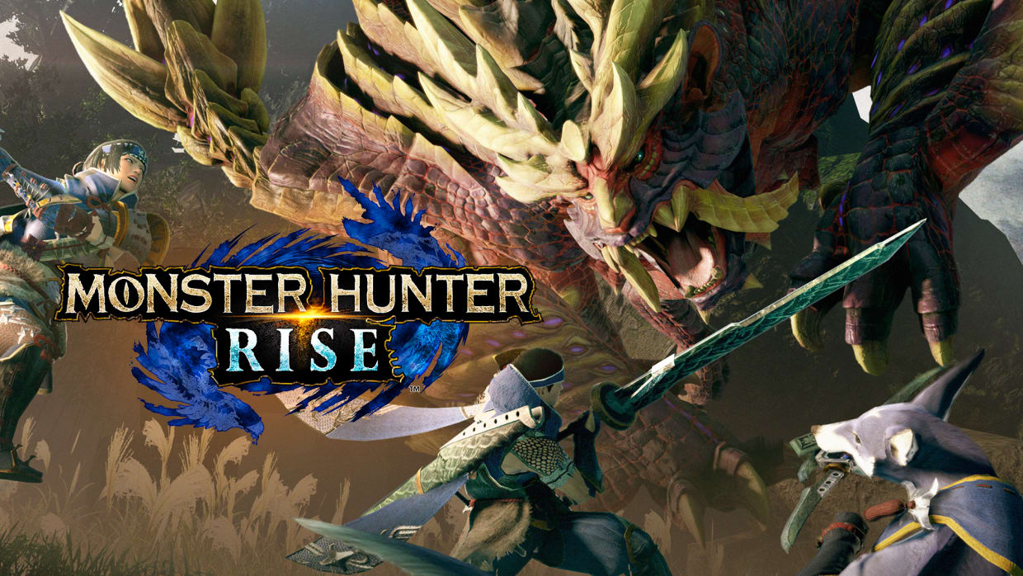


2021
Sold over 15 Million Copies
Sold over 3 Million Copies
Sold over 1.6 Million Copies

Slide 13






2022
2022 was another stellar year for PC gaming, featuring a blend of AAA titles and standout indie games. Here are some of the most successful and acclaimed PC games of 2022:
Sold over 23 Million Copies
Sold over 23 Million Copies
Sold over 5 Million Copies
Sold over 36 Million Copies
Sold over 1 Million Copies
Sold over 50 Million Copies

Slide 14






2022
Sold over 1 Billion Copies
Sold over 20 Million Copies
Sold over 2 Million Copies
Sold over 3.5 Million Copies
Sold over 2 Million Copies
Sold over 3 Million Copies

Slide 15






2022
Sold over 1 Million Copies
Sold over 3 Million Copies
Sold over 4 Million Copies
Sold over 15 Million Copies
Sold over 8.4 Million Copies
Sold over 3 Million Copies

Slide 16






2022
Sold over 7.9 Million Copies
Sold over 90 Million Copies
Sold over 1.81 Million Copies
Sold over 1088000 Copies
Sold over 2.1 Million Copies
Sold over 15 Million Copies

Slide 17






2023
Some of the most successful PC games in 2023 included a mix of immersive RPGs, unique puzzle experiences, and standout horror games, each earning high praise for different reasons:
Sold over 5.2 Million Copies
Sold over 10 Million Copies
Sold over 5 Million Copies
Sold over 1.3 Million Copies
Sold over 1 Million Copies
Sold over 1.2 Million Copies

Slide 18




2023
Sold over 20.61 Million Copies
Sold over 11 Million Copies
Sold over 3 Million Copies
Sold over 12 Million Copies

Slide 19






2024
As of 2024, several PC games have gained significant popularity and acclaim. Here are some of the standout titles:
Sold over 4.3 Million Copies
Sold over 1 Million Copies
Sold over 3 Million Copies
Sold over 60000 Copies
Sold over 1.5 Million Copies
Sold over 5 Million Copies

Slide 20


2024
Sold over 2.5 Million Copies
Sold over 2.21 Million Copies

Slide 21
THANK YOU

